Slide 1
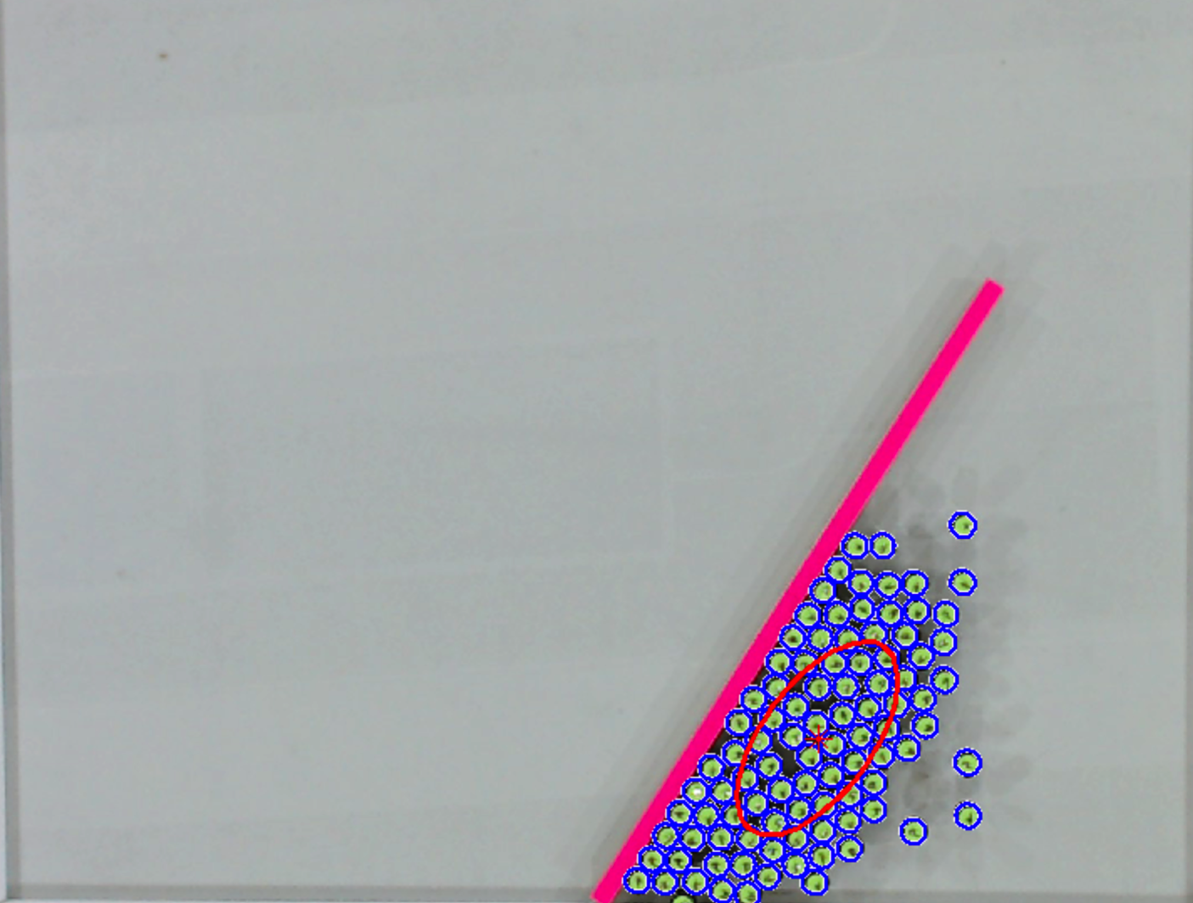

Detected Robots
Mean Position +
Covariance Ellipse
Object
Goal
Pivot
Notes:
Draw

Slide 2
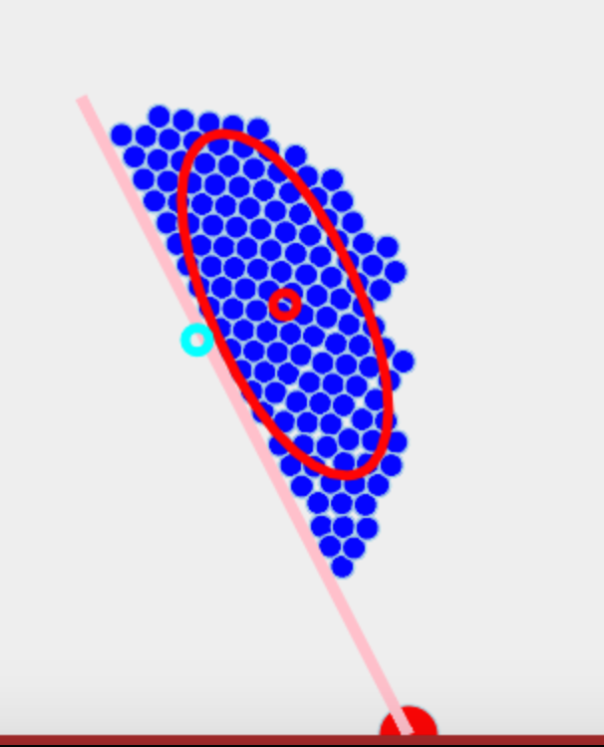
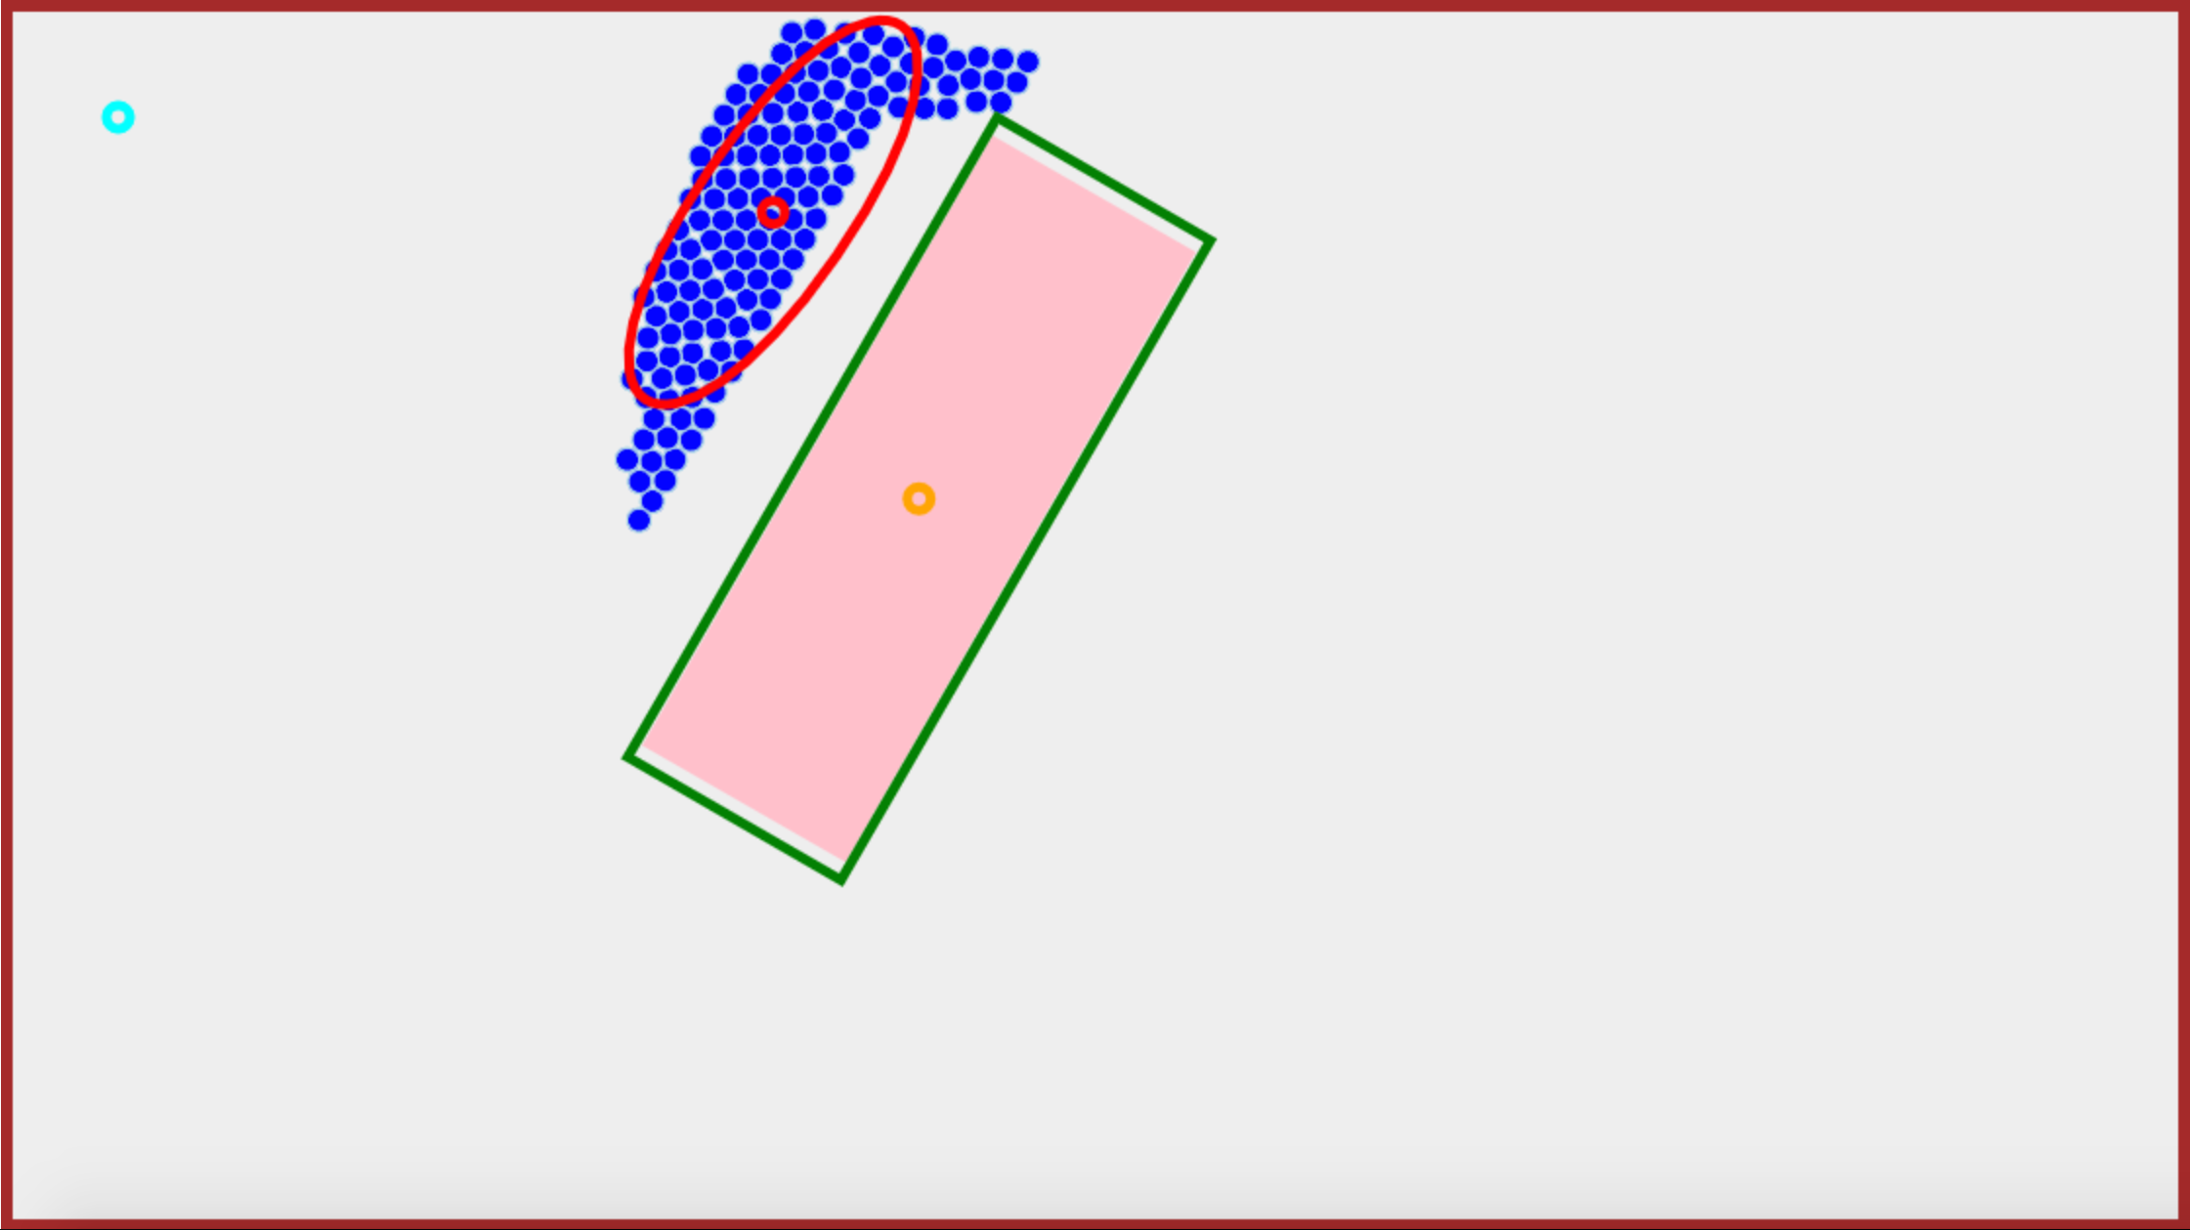
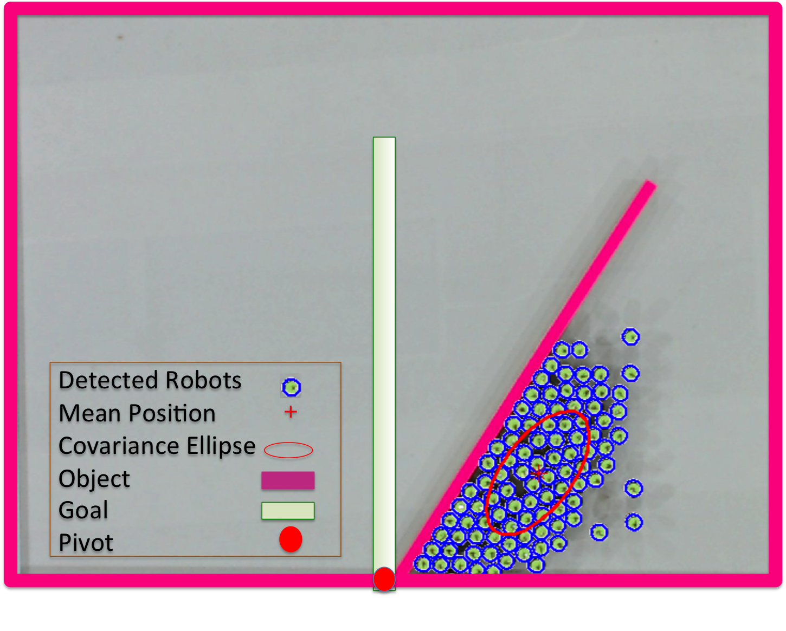
Robots
COM
Mean Position
Goal Position
Block
Goal Angle
a)
b)
c)
Direction of Light
θ

Slide 3
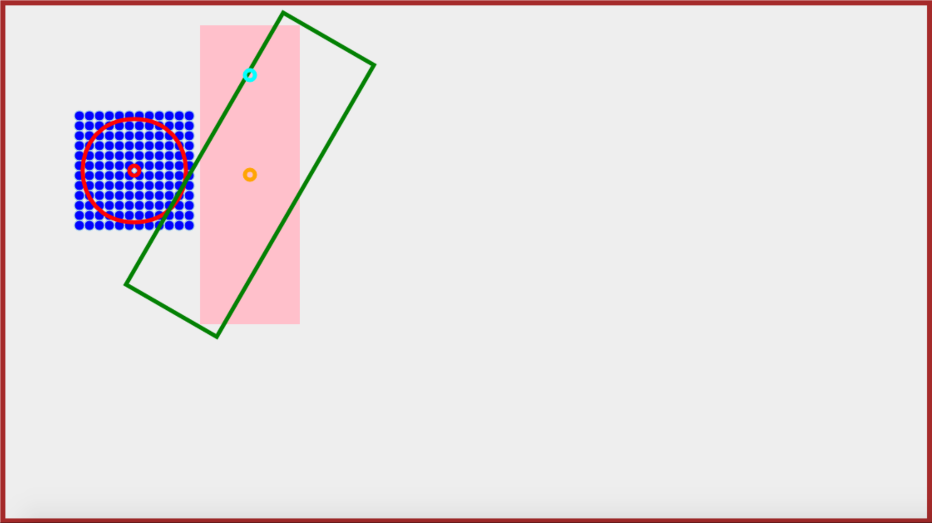
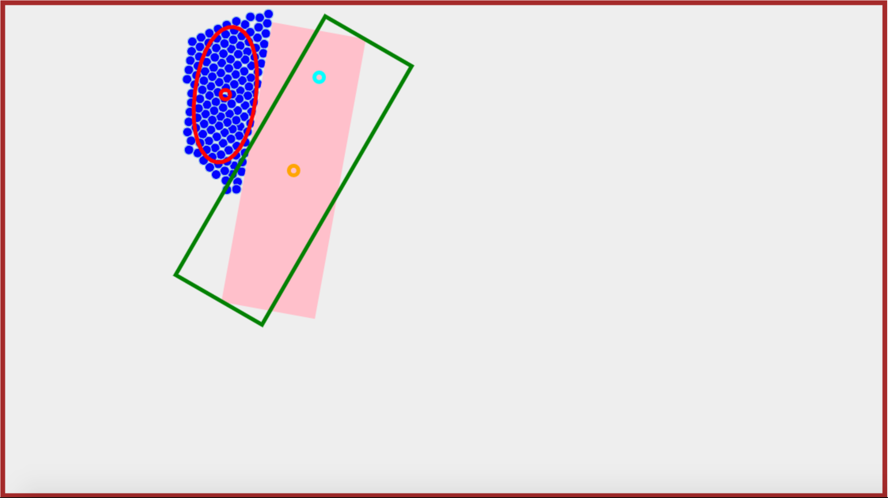
Robots
COM
Mean Position
Goal Position
Block
Goal Angle

Slide 4
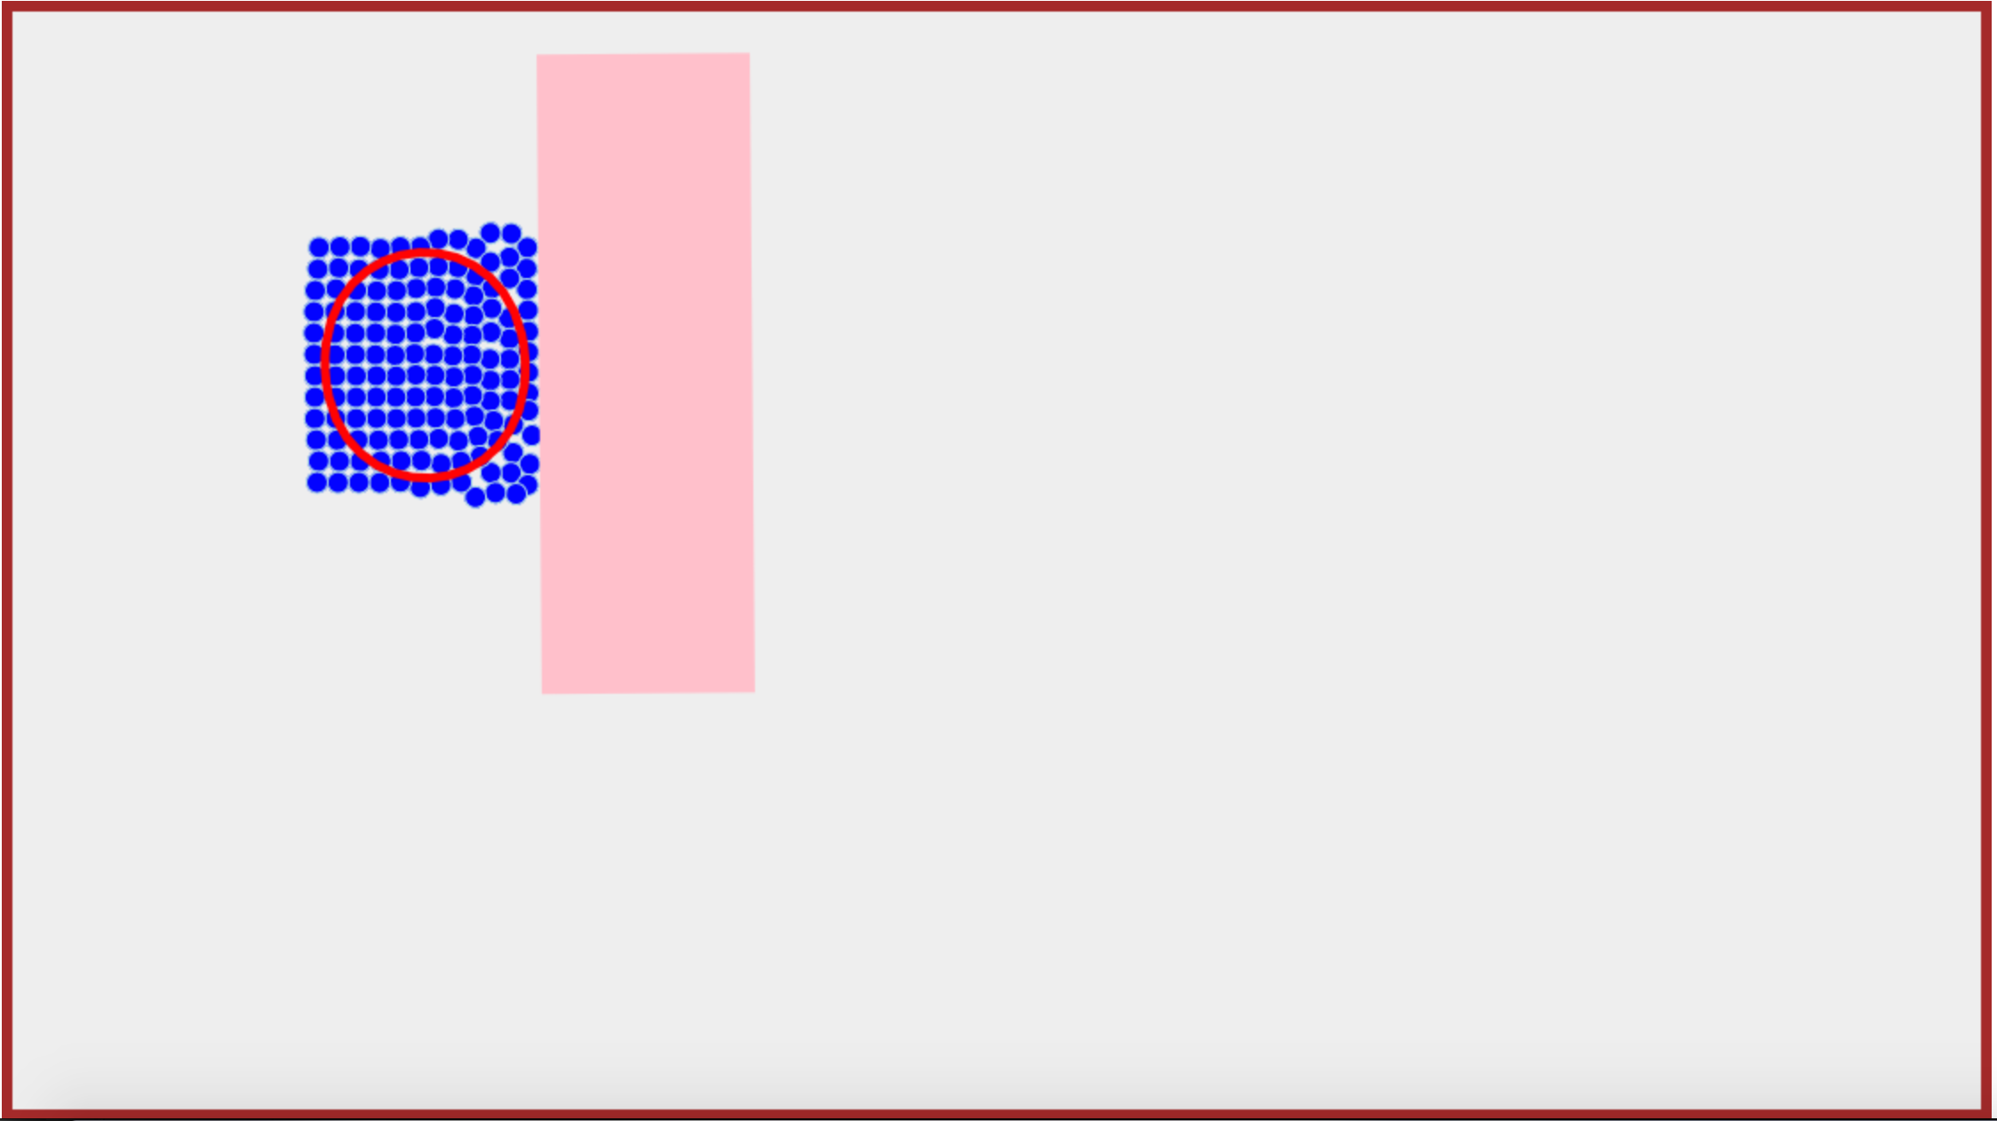
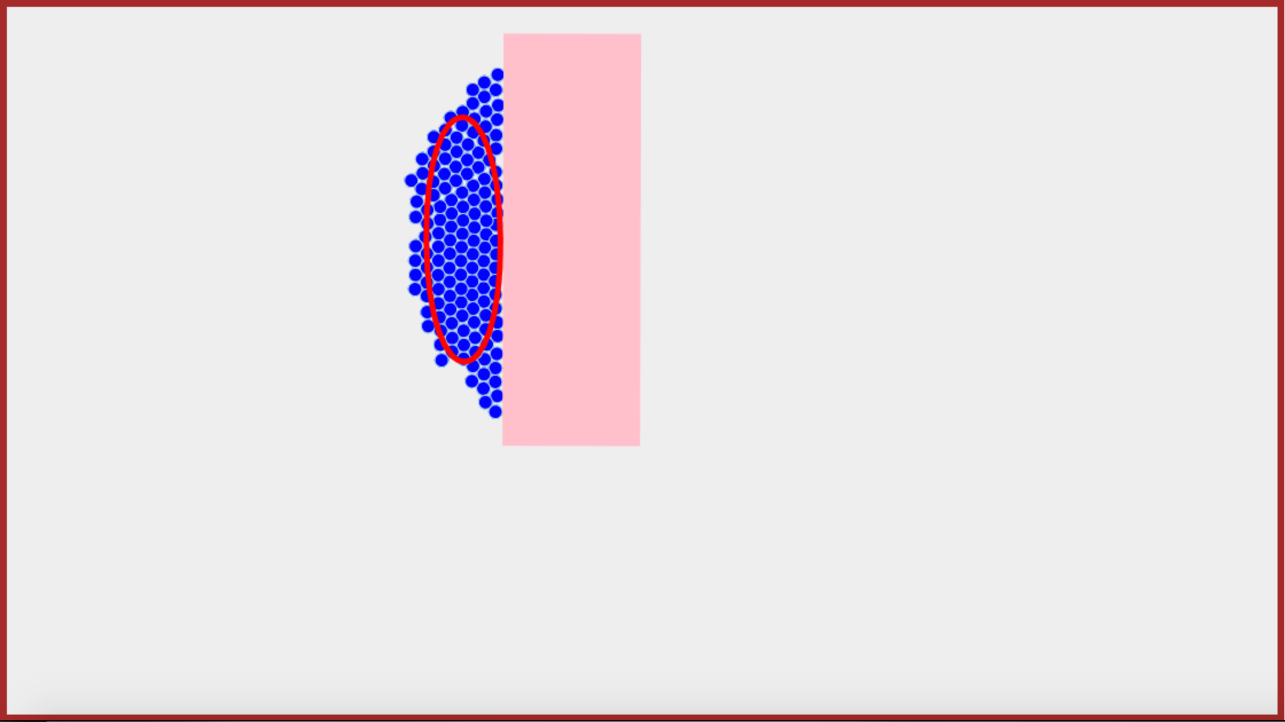
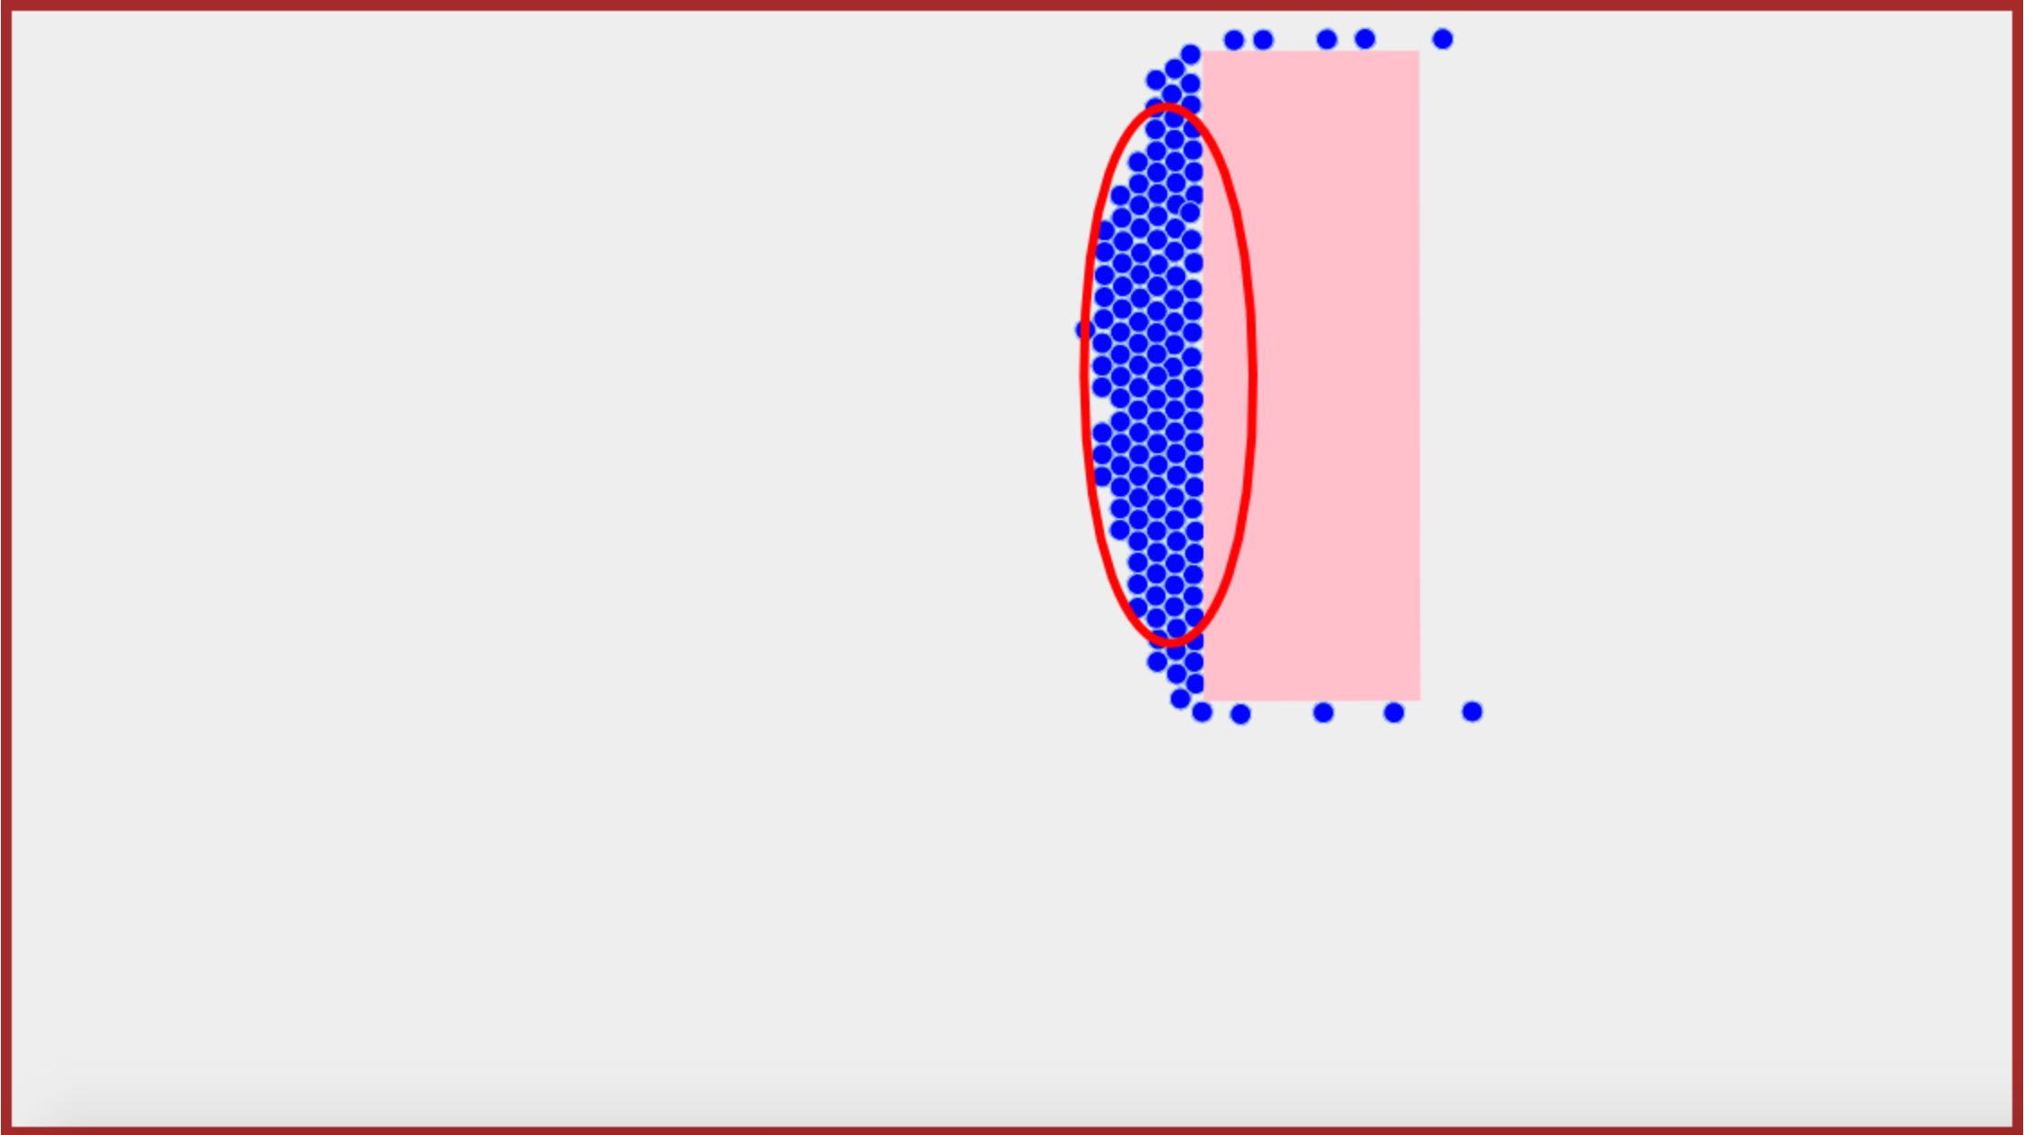
Robots
Covariance Ellipse
Block
12m
18m
25m

Slide 5
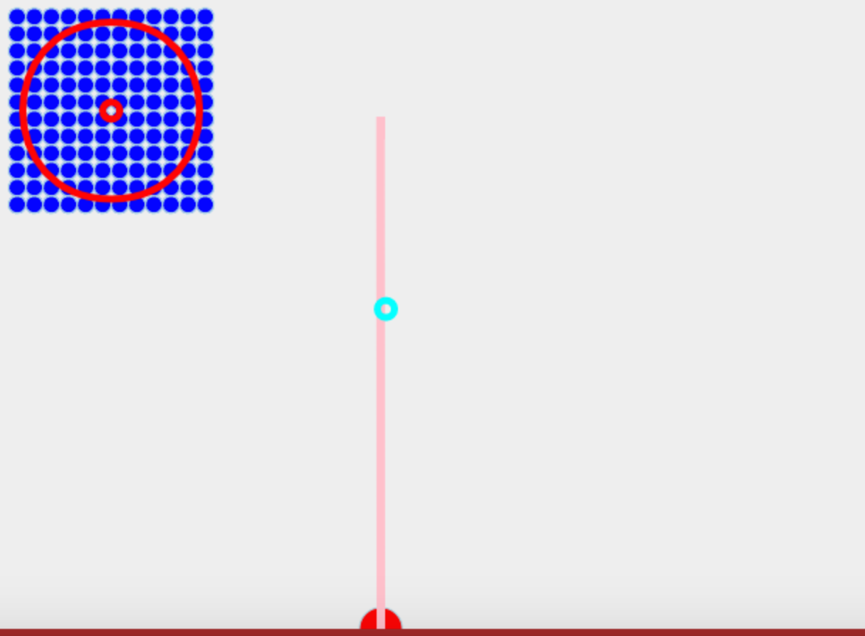
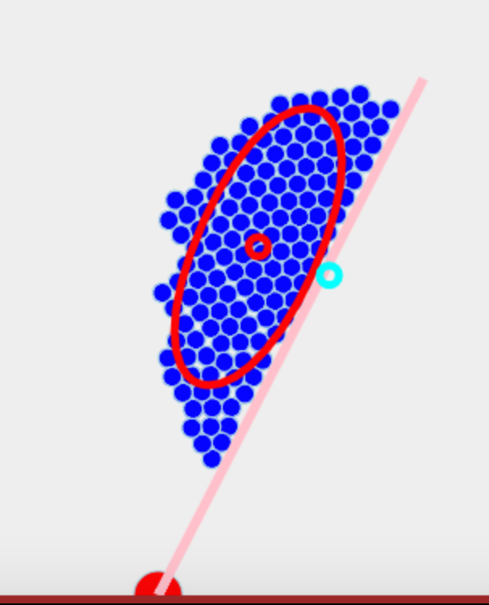
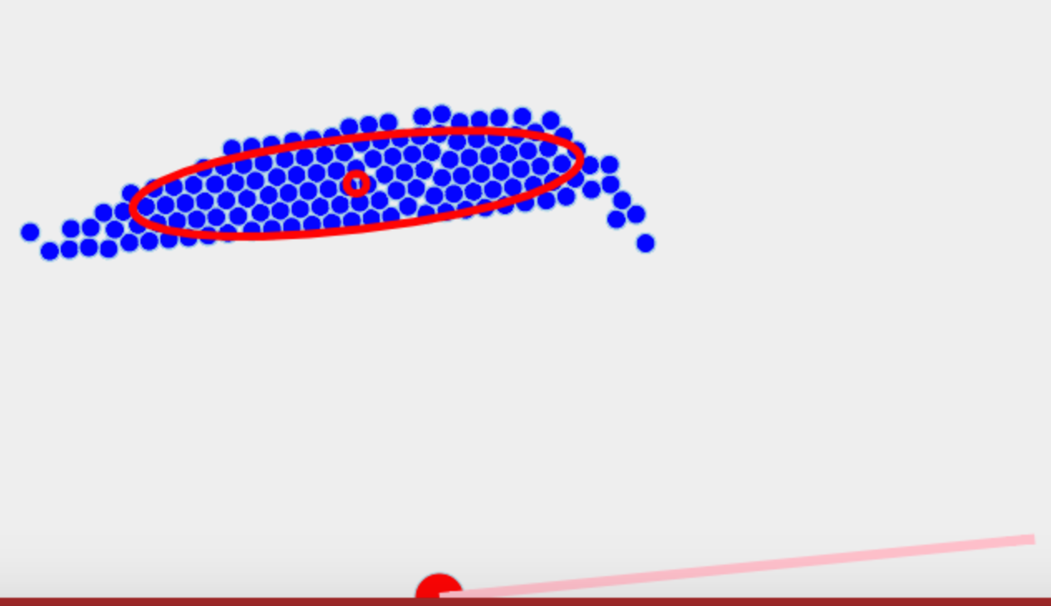
t = 0
t = 15
t = 30
Robots
Mean Position
Goal Position
Block
Pivot

